Slide 1
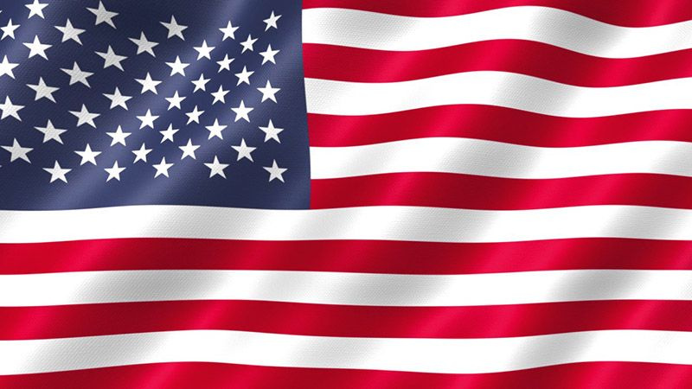
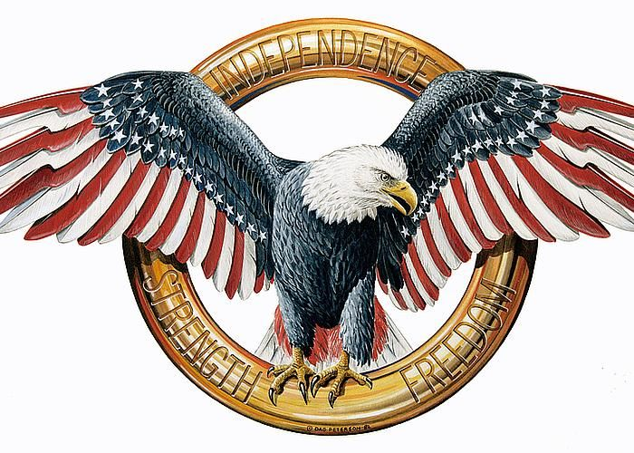
American Quiz

Slide 2

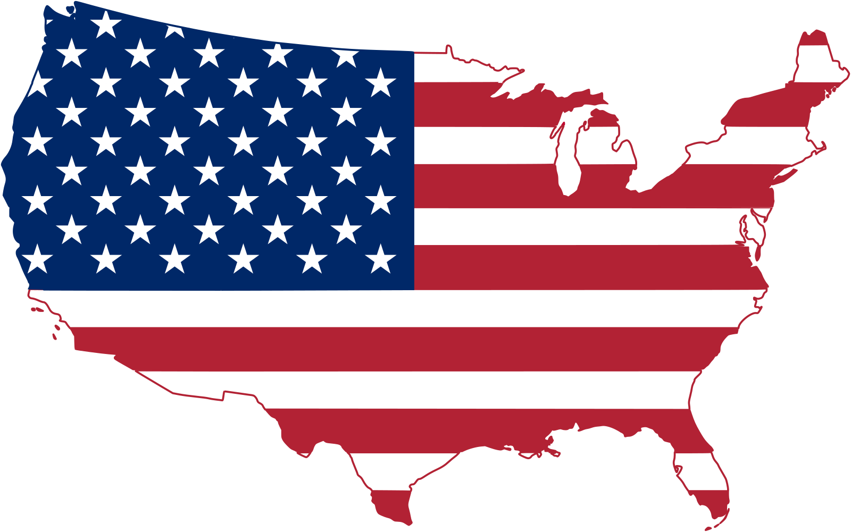
Cities
10
20
30
40
50
History
10
20
30
40
50
Geography
10
20
30
40
50
Culture
10
20
30
40
50
States
10
20
30
40
50

Slide 3
Cities 10
In which city is the Statue of Liberty located?

Slide 4
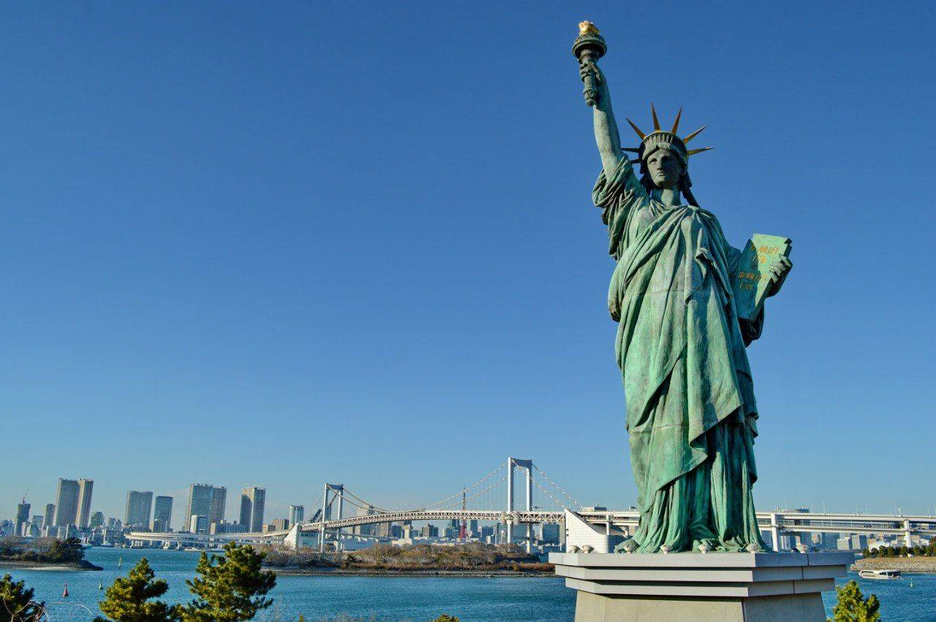
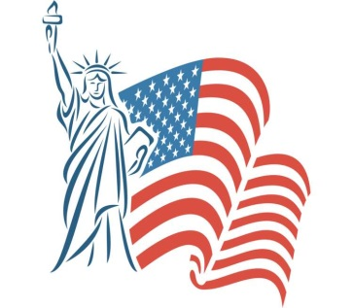
The Statue of Liberty is located in New York City.

Slide 5
Cities 20
The National Mall with attractions such as the Washington Monument and the Lincoln Memorial is located in which city?

Slide 6
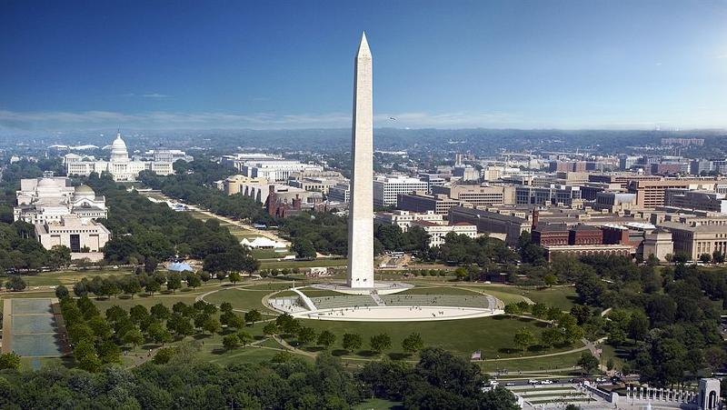
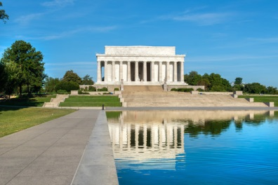
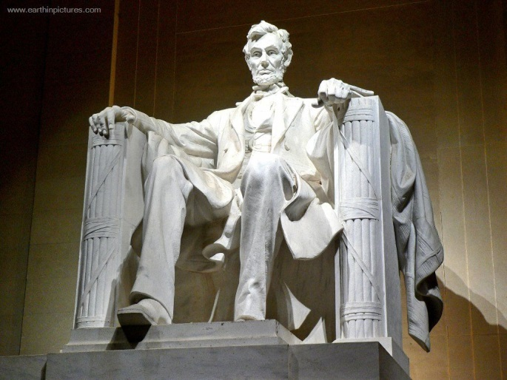
The Washington Monument and the Lincoln Memorial is located in Washington, DC.

Slide 7
Cities 30
What an unofficial nickname for New York.

Slide 8
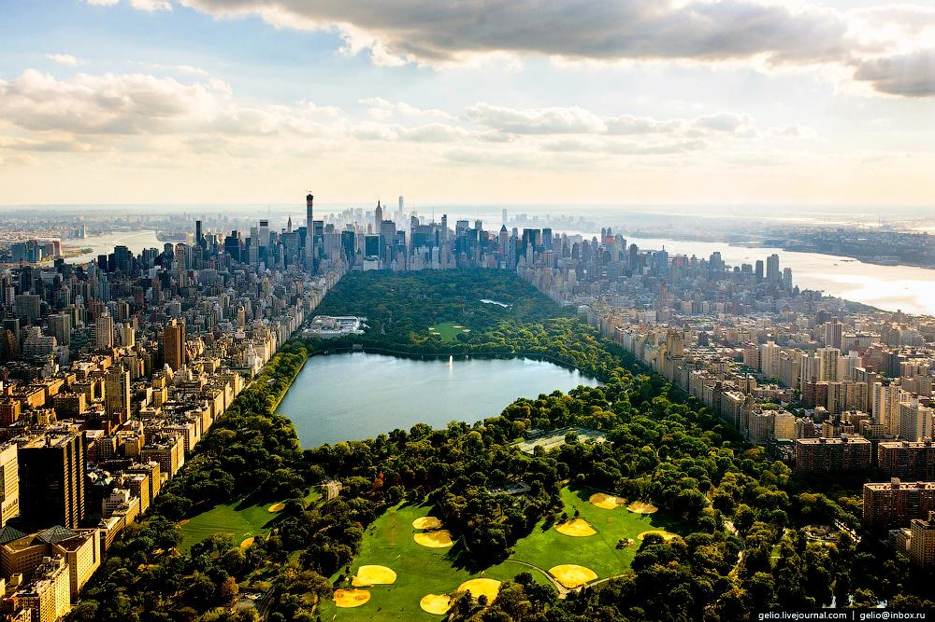
New York's unofficial nickname is the "Big Apple."

Slide 9
Cities 40
In which city is the famous Hollywood located?

Slide 10
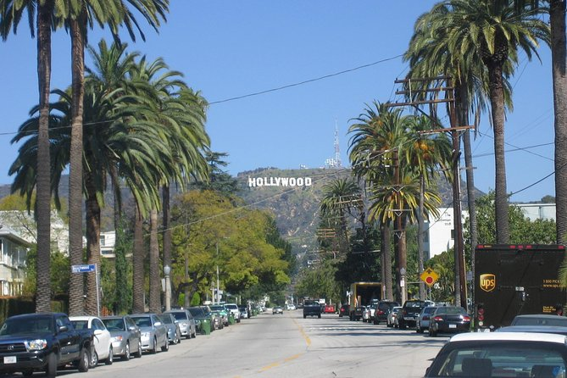
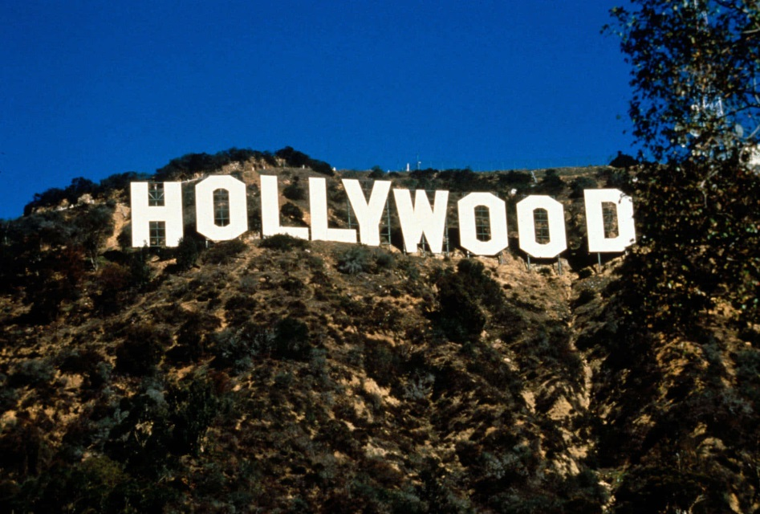
Hollywood is located in Los Angeles, California.

Slide 11
Cities 50
What is the name of the capital of California?

Slide 12
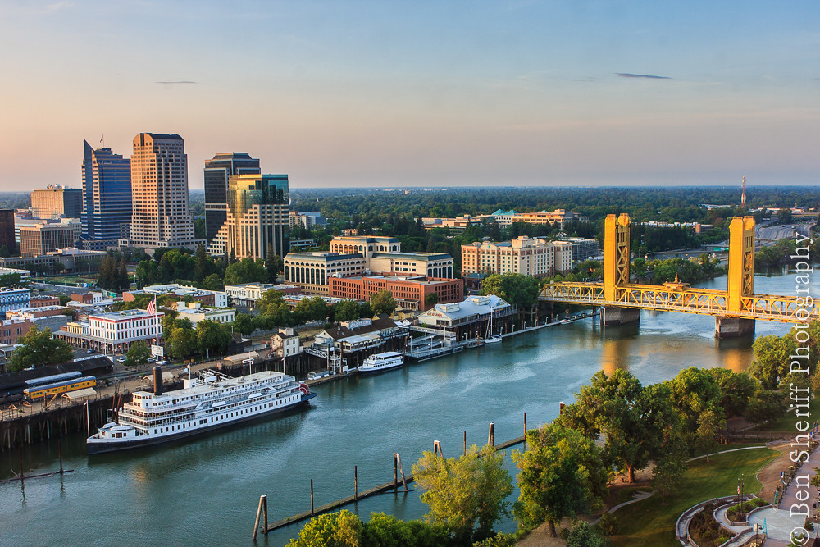
The capital of California is Sacramento.

Slide 13
History 10
Who was the first president of the United States?

Slide 14
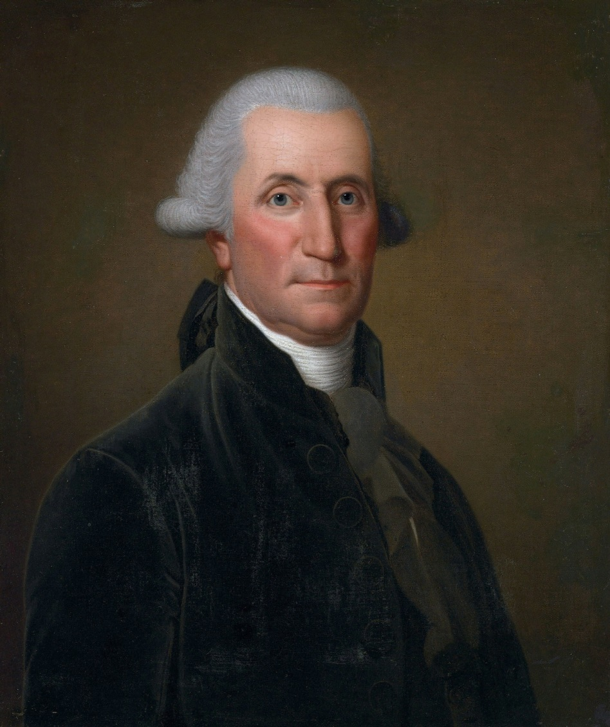
George Washington was the first president of the United States.

Slide 15
History 20
Which country did the United States acquire the territory of Alaska from?

Slide 16
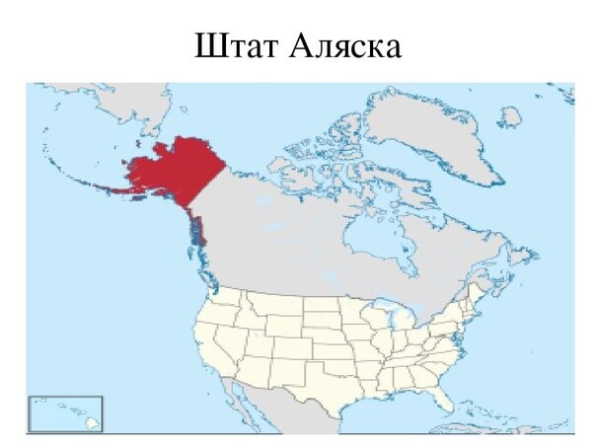
The United States acquired the territory of Alaska from Russia.
It was a deal between the governments of the Russian Empire and the United States of America, as a result of which, in 1867, Russia sold its holdings in North America with a total area of 1,518,800 km2 for 7.2 million dollars.

Slide 17
History 30
Who was the main author of the Declaration of Independence?

Slide 18
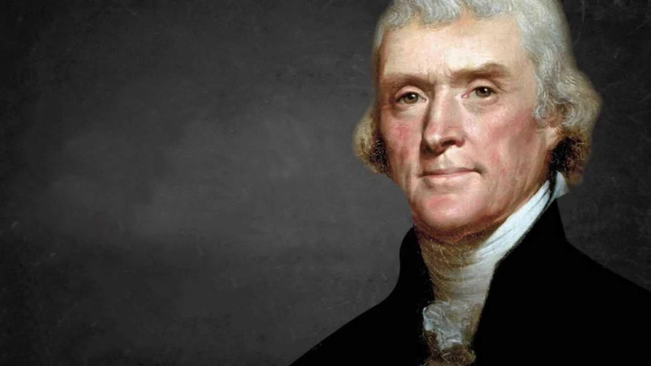
Thomas Jefferson became the main author of the Declaration of Independence of the United States.

Slide 19
History 40
What event marked the beginning of the U.S. involvement in World War II?

Slide 20
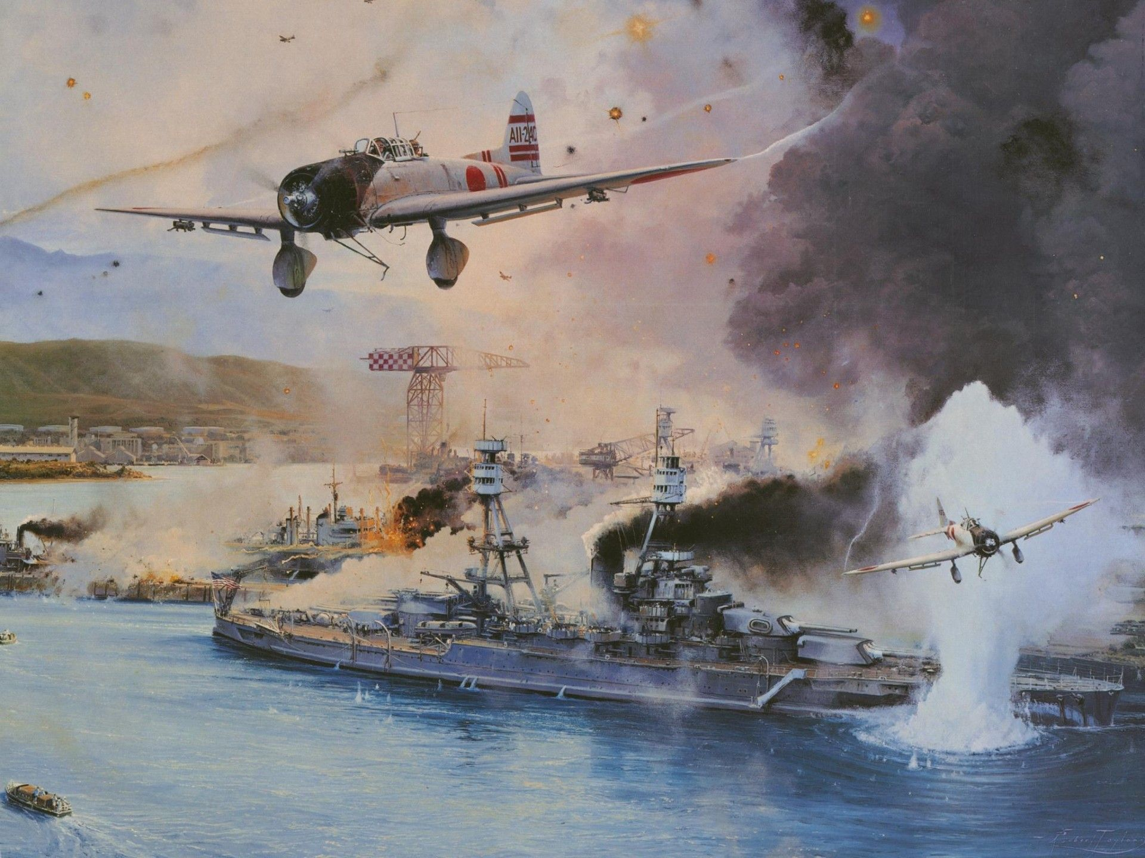
The attack on Pearl Harbor on December 7, 1941 marked the beginning of the U.S. involvement in World War II.

Slide 21
History 50
What is the purpose of the Civil Rights Act of 1964?

Slide 22
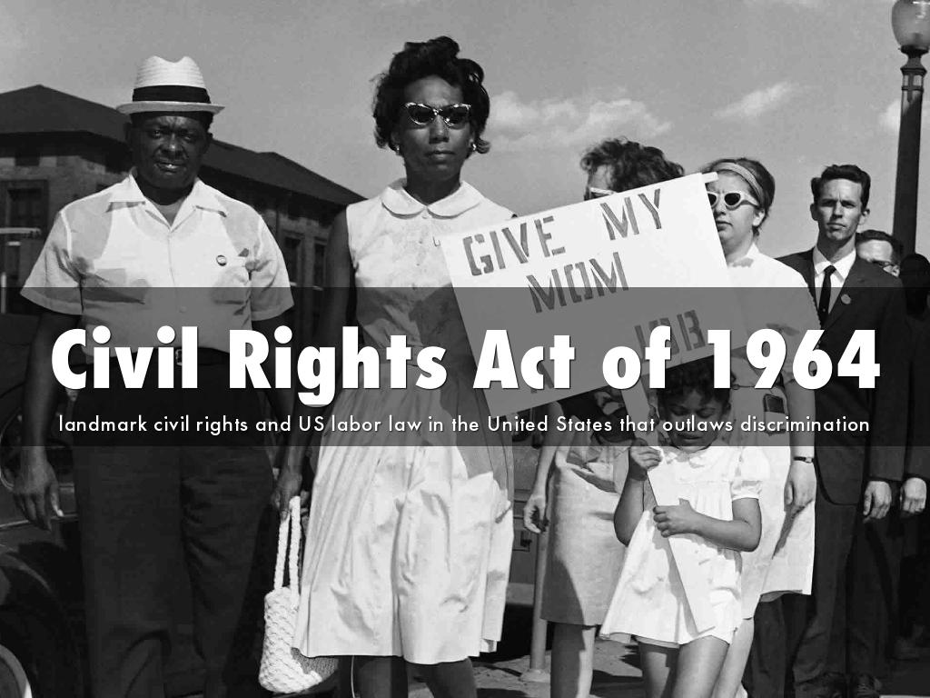
The purpose of the Civil Rights Act of 1964 is to prohibit discrimination based on race, skin color, gender, or ethnicity.

Slide 23
Geography 10
What is the name of the capital of the United States?

Slide 24
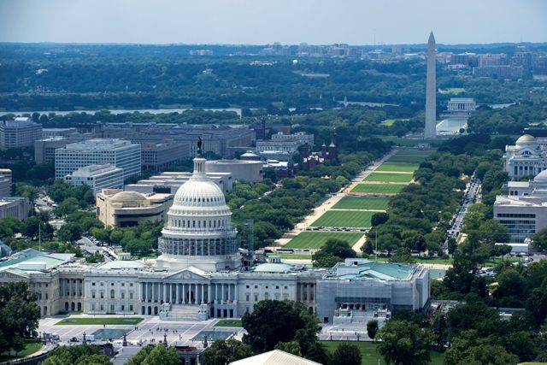
Washington, D.C. is the capital of the United States of America.

Slide 25
Geography 20
Which state in the United States is the largest by area?

Slide 26
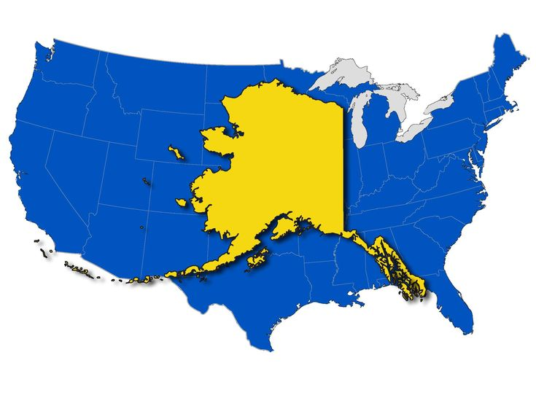
Alaska is the largest state in the United States by area.
Its total area is 665,384 square miles (1,723,337 square kilometers).

Slide 27
Geography 30
Which is the longest river in the United States?

Slide 28
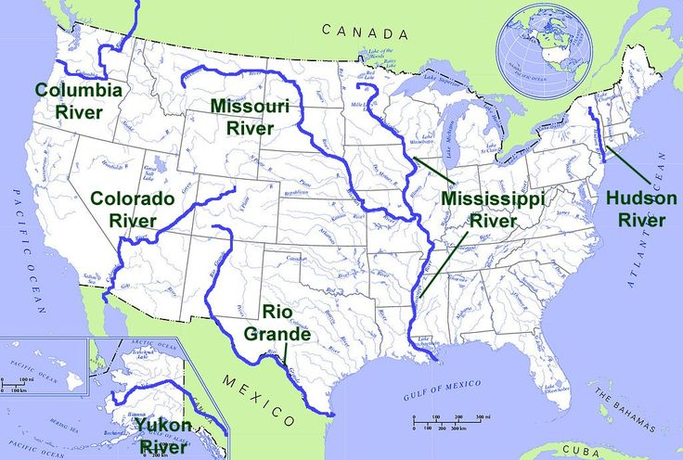
The Mississippi is the longest river in the United States (3,776 km).

Slide 29
Geography 40
Which mountain range runs along the western border of the United States?

Slide 30
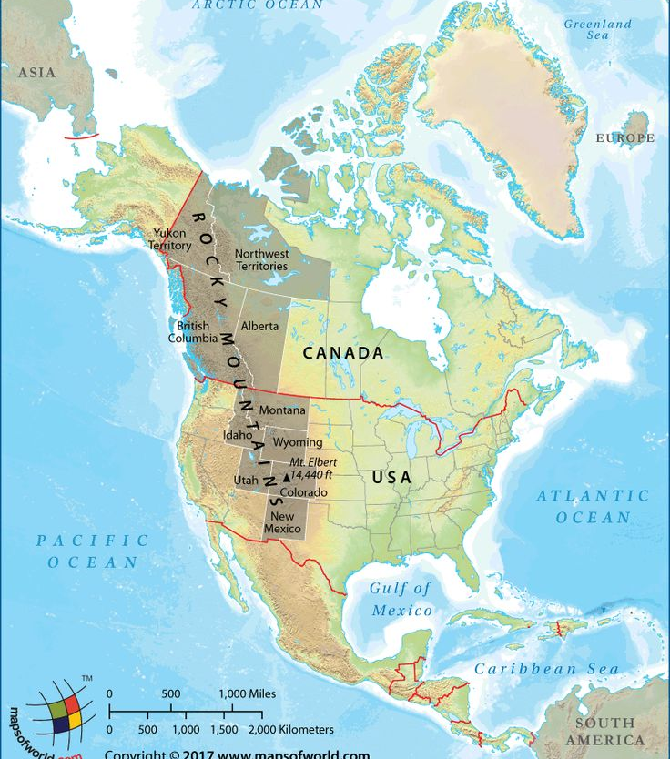
The Rocky Mountains run along the western border of the United States. They stretch from New Mexico in the south through British Columbia and Alberta, Canada, to Alaska in the United States.

Slide 31
Geography 50
In which state of the USA is the Grand Canyon located?

Slide 32
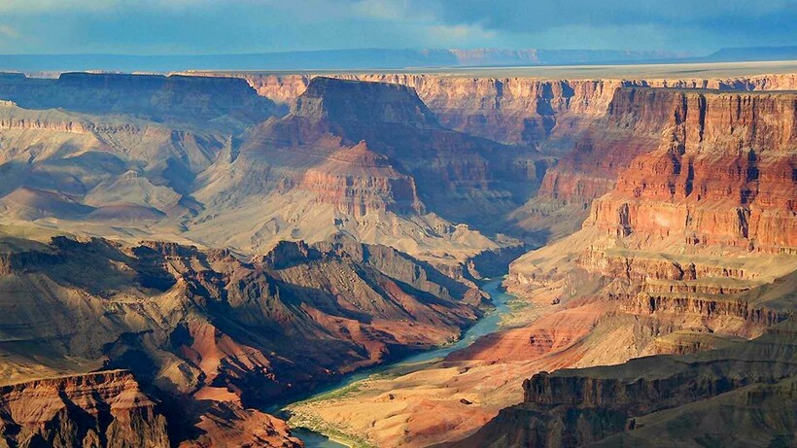
The Grand Canyon is located in Arizona.

Slide 33
Culture 10
What is the official language in the USA?

Slide 34

The official language in the USA is English.

Slide 35
Culture 20
Which bird is considered the national bird of the United States?

Slide 36
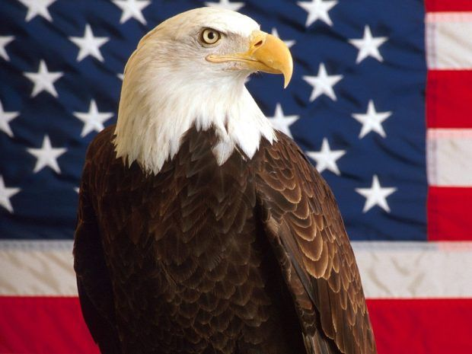
The bald eagle has been the national bird of the United States since 1782, a symbol of pride and strength that earned it a place on the seal of the United States.

Slide 37
Culture 30
Which country gave the Statue of Liberty to the United States?

Slide 38
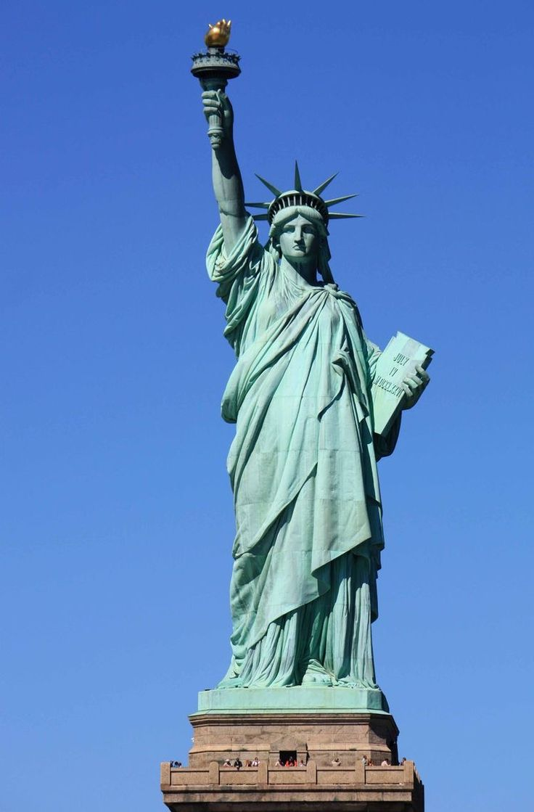
The Statue of Liberty was given to the United States by France, as a symbol of the two countries' friendship.

Slide 39
Culture 40
LUCKY NUMBER!

Slide 40
+ 20 points

Slide 41
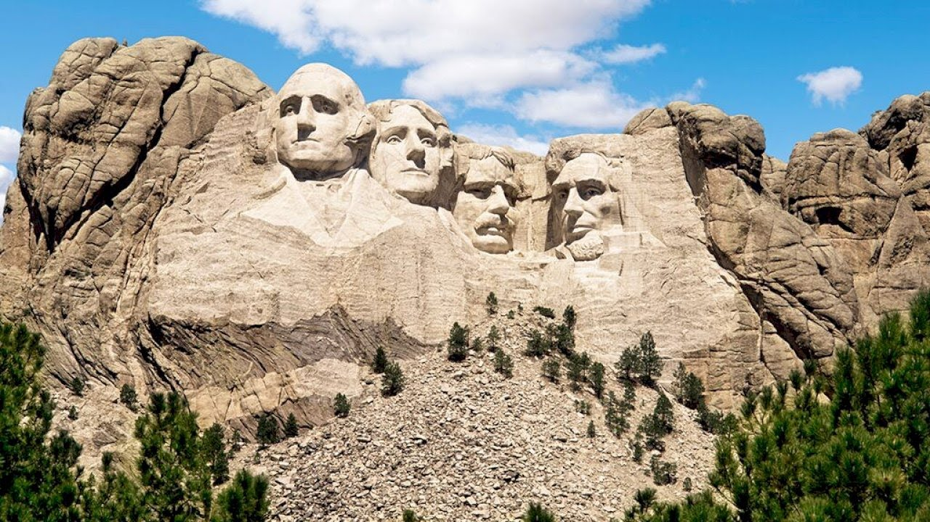
Culture 50
Who is depicted on the famous Mount Rushmore?

Slide 42
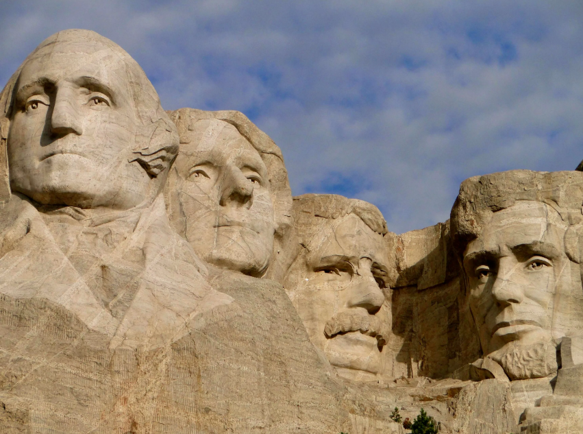
Mount Rushmore National Memorial features the faces of four presidents — George Washington, Thomas Jefferson, Theodore Roosevelt, and Abraham Lincoln — carved into Mount Rushmore in the Black Hills region of South Dakota.

Slide 43
States 10
How many states are part of the United States of America?

Slide 44
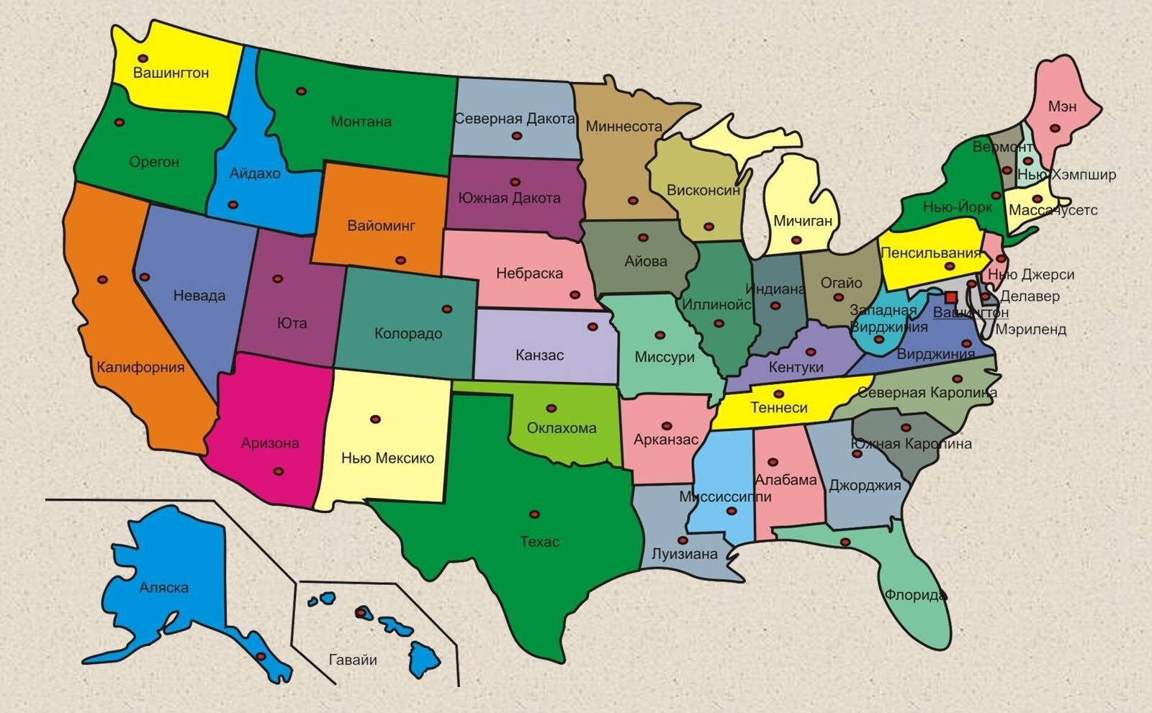
The United States of America consists of 50 states.

Slide 45
States 20
Which state is located on the islands?

Slide 46
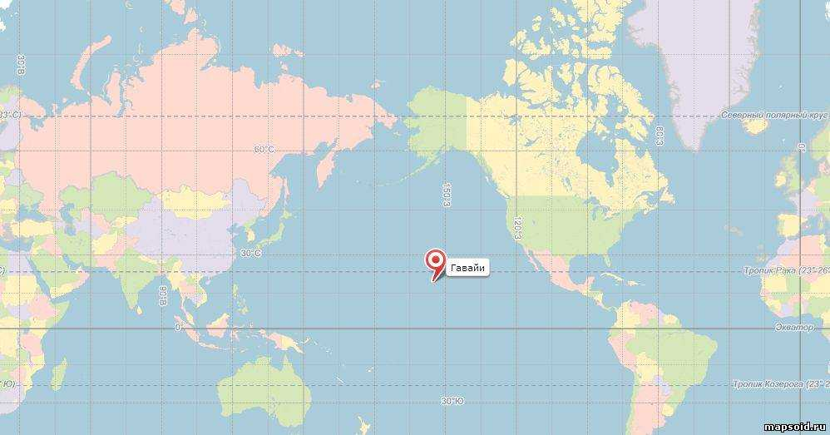
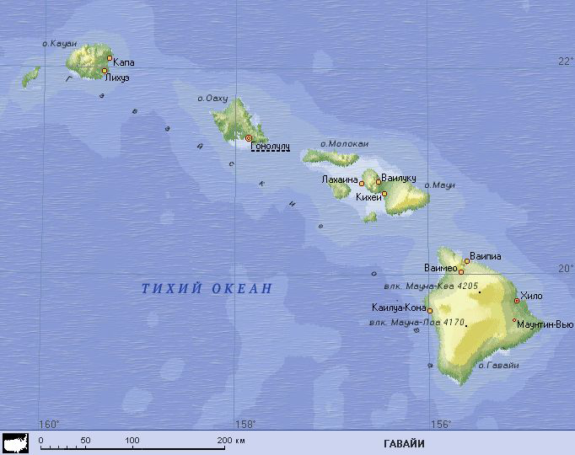
Hawaii is the only state in the United States that is located entirely on islands.

Slide 47
States 30
Which U.S. state is known as the "Lone Star State"?

Slide 48
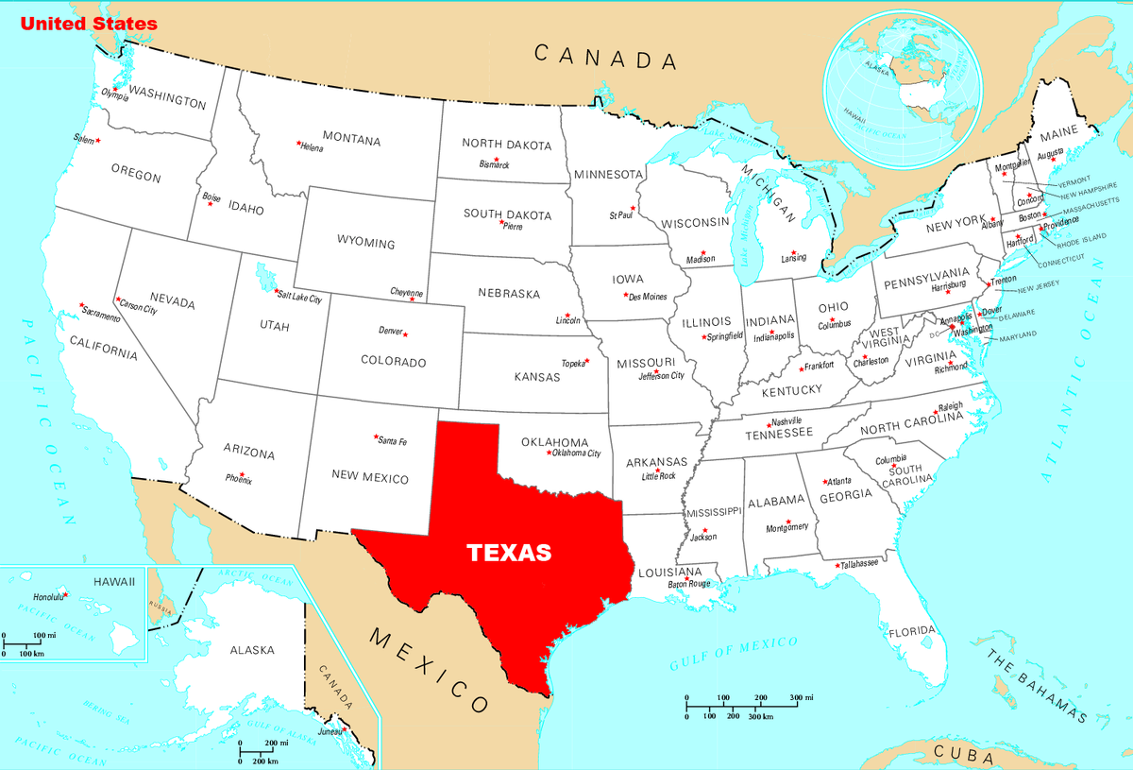
The "Lone Star State" is the official nickname of the state of Texas.

Slide 49
States 40
Which US state is known as the "Sunshine State"?

Slide 50
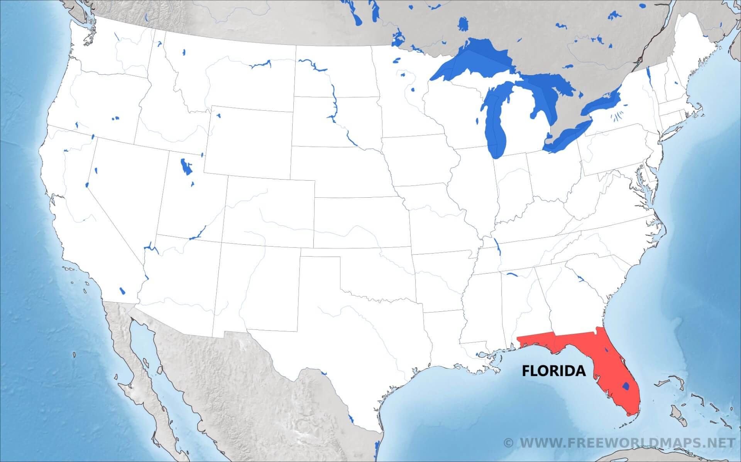
"Sunshine State" is the nickname of the state of Florida.

Slide 51
States 50
Which U.S. state is known as the "Empire State"?

Slide 52
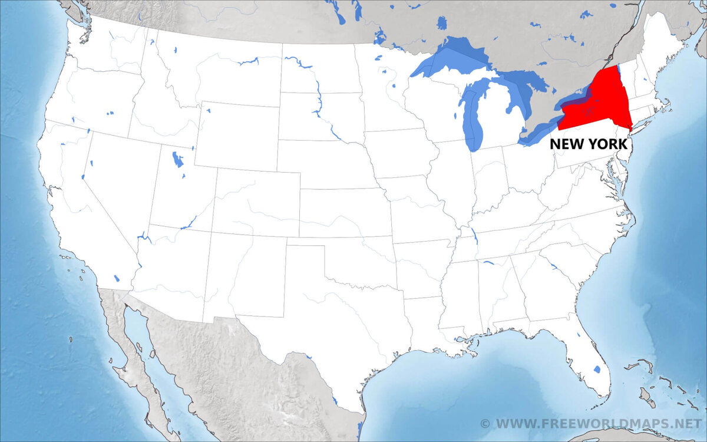
The Empire State is a nickname for the U.S. state of New York.

Slide 53

Thanks for playing

